Slide 1
Scratch
An introduction

Slide 2
What is scratch?
With Scratch, you can program your own interactive stories, games, and animations — and share your creations with others in the online community.
Scratch helps young people learn to think creatively, reason systematically, and work collaboratively — essential skills for life in the 21st century.
Scratch is a project of the Lifelong Kindergarten Group at the MIT Media Lab. It is provided free of charge.

Slide 3
Functionalities of scratch
The Scratch interface has three main sections: a stage area, blocks palette, and a coding area to place and arrange the blocks into runnable scripts.
The stage area features the results (i.e., animations, turtle graphics, etc., either in a small or normal size, with a full-screen option also available) and all sprites thumbnails being listed in the bottom area. The stage uses x and y coordinates, with 0,0 being the stage center.
With a sprite selected at the bottom of the staging area, blocks of commands can be applied to it by dragging them from the blocks palette into the coding area. The Costumes tab, allows users can change the look of the sprite in order to create various effects, including animation. The Sounds tab allows attaching sounds and music to a sprite

Slide 4
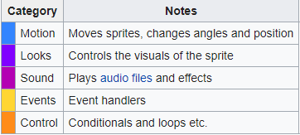
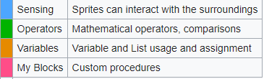
Functionalities of scratch
The table shows the categories of the programming blocks

Slide 5
Why scratch?
The ability to code computer programs is an important part of literacy in today’s society. When people learn to code in Scratch, they learn important strategies for solving problems, designing projects, and communicating ideas.

Slide 6
Reach of scratch
Scratch is used in more than 150 different countries and available in more than 40 languages. To change languages, click the menu at the bottom of the page. Or, in the Project Editor, click the globe at the top of the page.
Students are learning with Scratch at all levels (from elementary school to college) and across disciplines (such as math, computer science, language arts, social studies). Educators share stories, exchange resources, ask questions, and find people on the ScratchEd website.

Slide 7
Online forum
On Scratch, members have the capability to share their projects and get feedback. Projects can be uploaded directly from the development environment to the Scratch website and any member of the community can download the full source code to study or to remix into new projects. Members can also create project studios, comment, tag, favorite, and "love" others' projects, follow other members to see their projects and activity, and share ideas. Projects range from games to animations to practical tools. Additionally, to encourage creation and sharing amongst users, the website frequently establishes "Scratch Design Studio" challenges.

Slide 8
A project in scratch

Slide 9
Thank you hope you found this presentation informative
Members:
Mubeen Siddiqui(19K-1276)
Ahmed Raza(19K-0134)
Bassam Tariq(19k-0152)

Slide 10
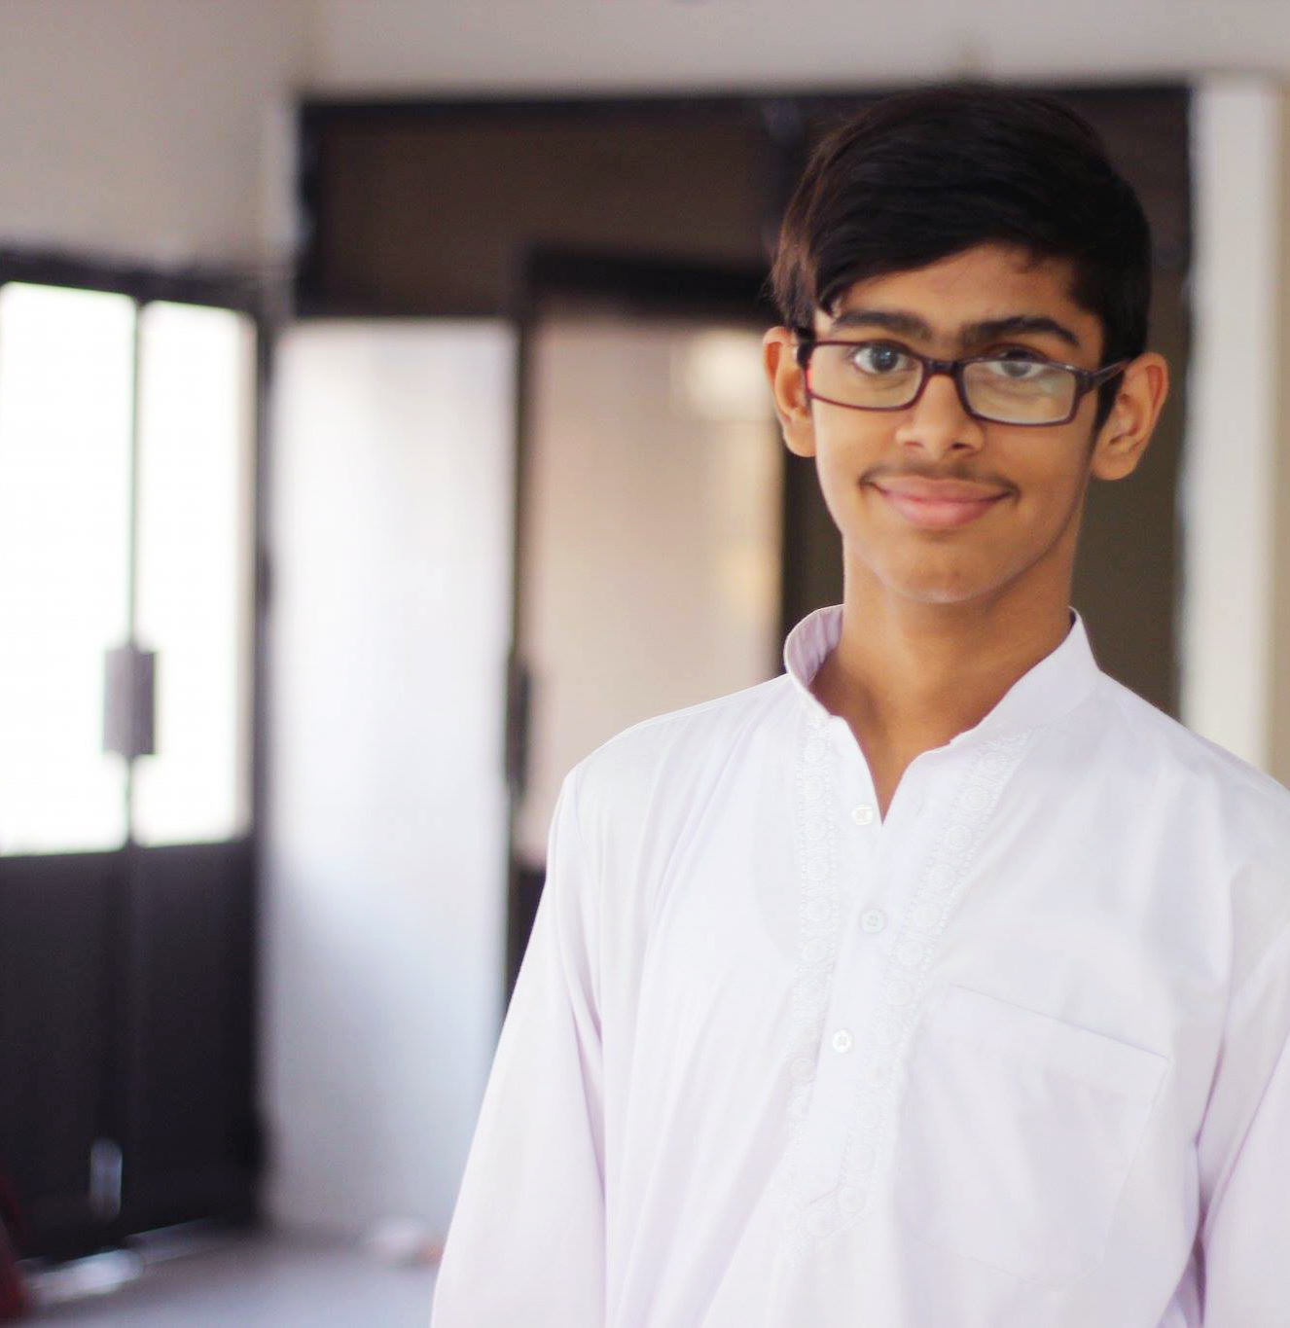
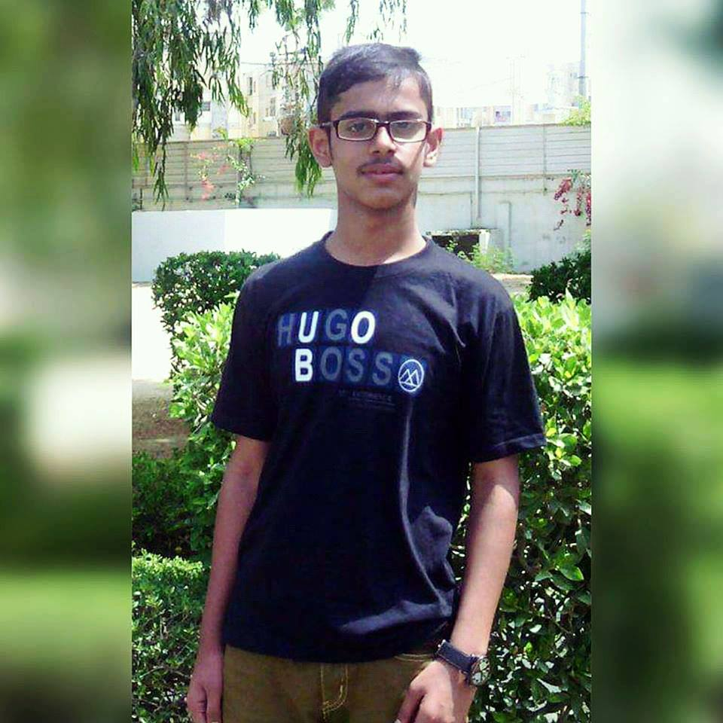

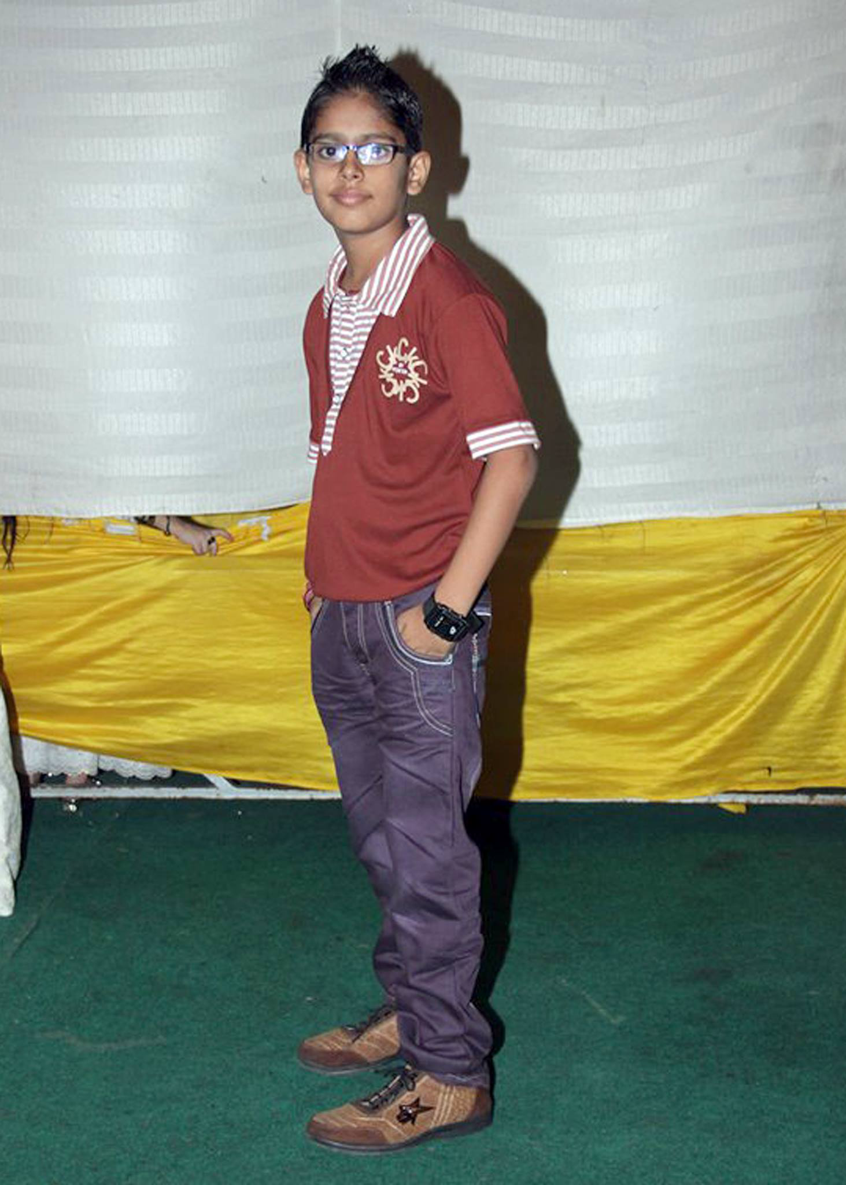
MVP
ASHMAL VAYANI

